Slide 1
Linear Programming Problem: Simplex Method
1st Step: Construct the initial table by putting decision variables equal to zero.
2nd Step: If optimal solution arise stop calculation, otherwise proceed to step 3.
3rd Step: Go to the Z-row and find the Entering variable whose coefficient in the Z-row is most negative.
4th Step: Find the Departing variable, i.e., the basic variable in the row where the quotient is as small as possible; yet non-negative.
5th Step: Find the Pivotal entry at the intersection of the entering variable-column and the departing variable-row.
6th Step: Use pivotal element for elemination (to get zero) and construct new table and return step-2.

Slide 2
Simplex Method: Example
# Problem: A company specializes in the production of three products chain, ring, bangles. The three products require metal and labor where supplies are limited. The following table gives the details.
 | Unit of Metal required | Unit of Labour required | Price (TK.)
Chain | 3 | 2 | 1
Ring | 2 | 1 | 1
Bangles | 1 | 2 | 3
Available Resources | 3 | 2

Slide 3
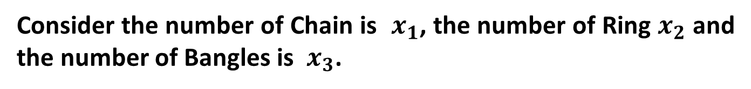
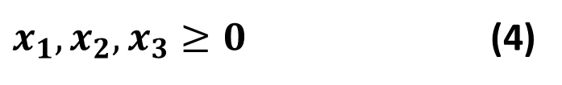
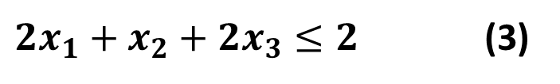
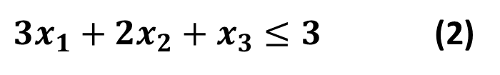
Mathematical form of the above problem:
Consider the number of Chain is $x_{1}$, the number of Ring $x_{2}$ and the number of Bangles is ${ x}_{3}$.
Maximum value: $Z=x_{1}+x_{2}+3x_{3}$ (1)
Subject to
$3x_{1}+2x_{2}+x_{3}≤3$ (2)
$2x_{1}+x_{2}+{2x}_{3}≤2$ (3)
$x_{1},x_{2},x_{3}≥0$ (4)

Slide 4
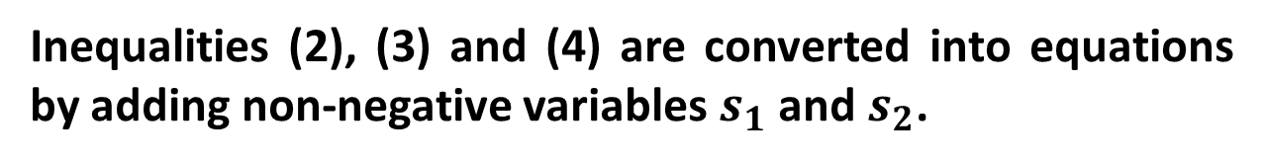
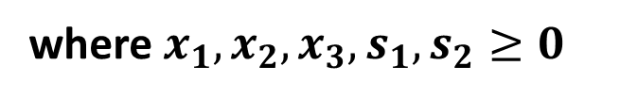
Simplex Method can be applied to solve the above problem.
Inequalities (2), (3) and (4) are converted into equations by adding non-negative variables $s_{1}$ and $s_{2}$.
$Z=x_{1}+x_{2}+3x_{3}+0 s_{1}+0$ $s_{2}$
$−x_{1}−x_{2}−3x_{3}+0 s_{1}+0 s_{2}+Z=0$ (5)
$3x_{1}+2x_{2}+x_{3}+s_{1}=3$ (6)
$2x_{1}+x_{2}+{2x}_{3}+s_{2}=2$ (7)
where$x_{1},x_{2},x_{3},s_{1},s_{2}≥0$

Slide 5

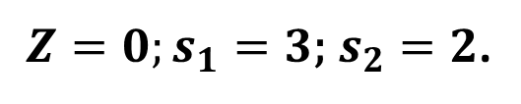

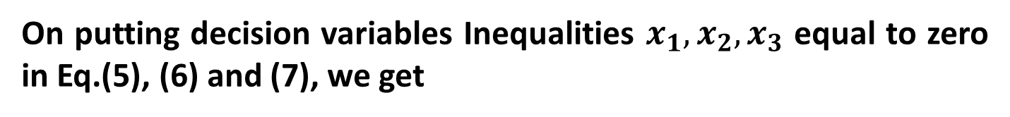

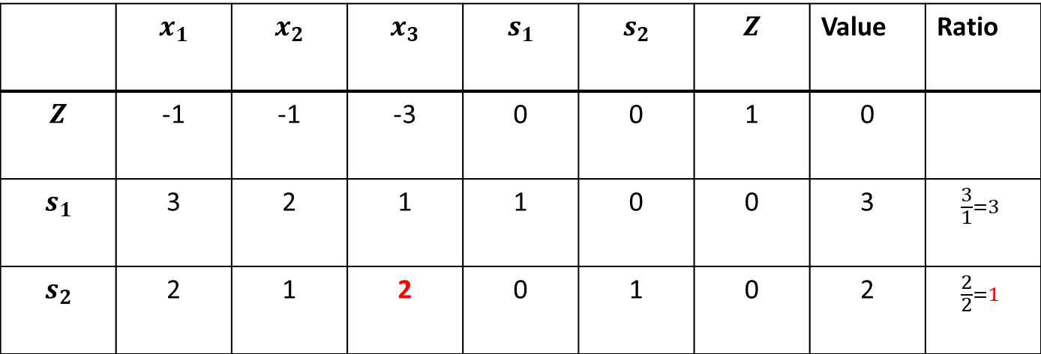
On putting decision variables Inequalities $x_{1},x_{2},x_{3}$ equal to zero in Eq.(5), (6) and (7), we get
$Z=0;s_{1}=3\text{;} s_{2}=2$.
Entering Variable (In Z-row, -3 is most negative)
 | $$x_{1}$$ | $$x_{2}$$ | $$x_{3}$$ | $$s_{1}$$ | $$s_{2}$$ | $$Z$$ | Value | Ratio
$$Z$$ | -1 | -1 | -3 | 0 | 0 | 1 | 0
$$s_{1}$$ | 3 | 2 | 1 | 1 | 0 | 0 | 3 | $$\frac{3}{1}=3$$
$$s_{2}$$ | 2 | 1 | 2 | 0 | 1 | 0 | 2 | $$\frac{2}{2}=1$$
$$R_{1}$$
$$R_{2}$$
$$R_{3}$$
Pivot Entry (at the intersection of $x_{3}$-column and $s_{2}$-row)
Departing Variable (The smallest ratio is 1 in the $s_{2}$-row)

Slide 6

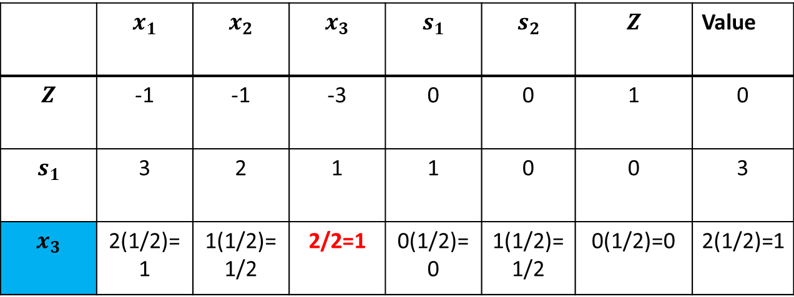


To make pivot entry 1, we multiply 3rd row by (1/2) and the table becomes
 | $$x_{1}$$ | $$x_{2}$$ | $$x_{3}$$ | $$s_{1}$$ | $$s_{2}$$ | $$Z$$ | Value
$$Z$$ | -1 | -1 | -3 | 0 | 0 | 1 | 0
$$s_{1}$$ | 3 | 2 | 1 | 1 | 0 | 0 | 3
$$x_{3}$$ | 2(1/2)=1 | 1(1/2)=1/2 | 2/2=1 | 0(1/2)=0 | 1(1/2)=1/2 | 0(1/2)=0 | 2(1/2)=1
$$R_{1}$$
$$R_{2}$$
$$R_{3}$$

Slide 7
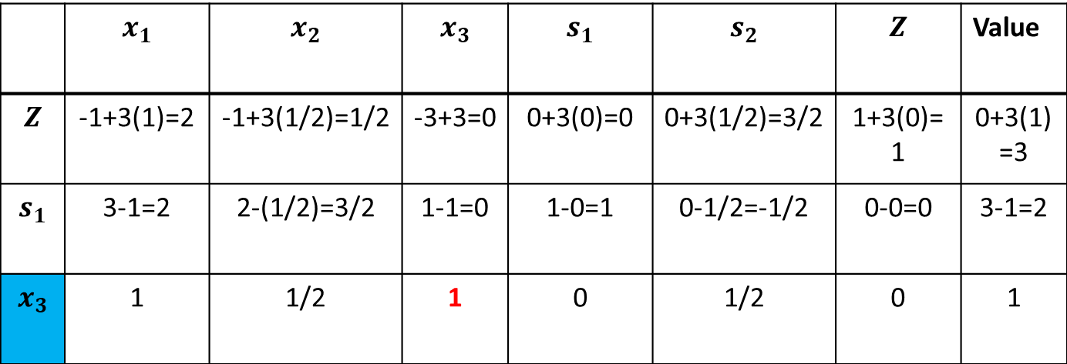
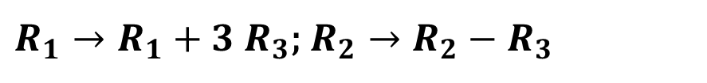
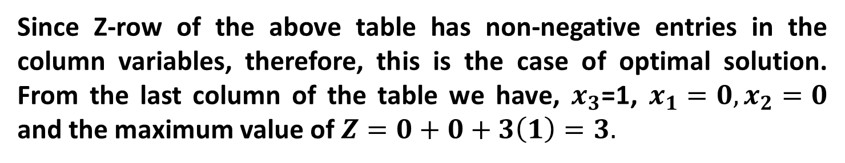



$R_{1}→R_{1}+3$ $R_{3}$; $R_{2}→R_{2}−$ $R_{3}$
 | $$x_{1}$$ | $$x_{2}$$ | $$x_{3}$$ | $$s_{1}$$ | $$s_{2}$$ | $$Z$$ | Value
$$Z$$ | -1+3(1)=2 | -1+3(1/2)=1/2 | -3+3=0 | 0+3(0)=0 | 0+3(1/2)=3/2 | 1+3(0)=1 | 0+3(1)=3
$$s_{1}$$ | 3-1=2 | 2-(1/2)=3/2 | 1-1=0 | 1-0=1 | 0-1/2=-1/2 | 0-0=0 | 3-1=2
$$x_{3}$$ | 1 | 1/2 | 1 | 0 | 1/2 | 0 | 1
$$R_{1}$$
$$R_{2}$$
$$R_{3}$$
Since Z-row of the above table has non-negative entries in the column variables, therefore, this is the case of optimal solution. From the last column of the table we have, $x_{3}$=1, $x_{1}=0,x_{2}=0$ and the maximum value of $Z=0+0+3\left(1\right)=3.$

